Slide 1


From task-specific robots to generalist foundation models
3 November 2026
MACHINE LEARNING & DEEP LEARNING · PAPER PRESENTATION
A deep dive into Octo and OpenVLA
PRESENTED BY
PROFESSOR
M. Haroon Khan · Mayet Bekele Sharew · Ahmad Rammal · Maksym Necheporenko
Joaquin Jorge Rodriguez
Notes:
~1 min. Greet, introduce the four of us and the topic. Two papers: Octo (Octo Model Team, RSS 2024) and OpenVLA (Kim et al., CoRL 2024). Both are open-source attempts at one robot policy that works across many robots and tasks.

Slide 2

One policy for many robots, tasks and sensors
THE BIG PICTURE
NOW
BEFORE
Pretrain one generalist robot policy on many robots’ data, then fine-tune it with a little in-domain data.
Collect data for one robot and one task, then train a policy from scratch. Repeat for every new task.
01
Octo: a small, flexible transformer policy
02
OpenVLA: a 7B VLM that outputs actions
03
Side-by-side comparison and conclusion
Octo vs. OpenVLA · Machine Learning & Deep Learning
02
Notes:
~1 min. The usual approach trains a new policy per robot and task, which needs lots of data each time and generalises poorly. Like foundation models in NLP and vision, the goal is a generalist robot policy (GRP) or vision-language-action model (VLA) pretrained on diverse multi-robot data, then adapted cheaply. Roadmap: Octo, then OpenVLA, then a comparison.

Slide 3
Both are trained on Open X-Embodiment
SHARED TRAINING DATA
A community pool of robot demonstrations from many labs and robots, in one common format.
Octo’s subset
OpenVLA’s subset
800k trajectories
970k trajectories
70+
25 datasets kept: those with images and delta end-effector control
Doubled the weight of more diverse datasets
Zero-padded missing cameras
Kept single-arm, end-effector data with a third-person camera
Reused Octo’s mixture weights
Tried DROID, dropped it late in training
robot datasets
2M+
trajectories (about 1.5M when Octo was trained)
Octo §III-B · OpenVLA §3.3
03
Notes:
~1 min. Open X-Embodiment (OXE) pooled robot learning datasets from many institutions into one format. When OpenVLA was written it had more than 70 datasets and over 2M trajectories; Octo describes it as about 1.5M episodes. Octo curated 25 datasets (800k trajectories): removed datasets with no image streams or without delta end-effector control, plus repetitive, low-resolution or niche ones; doubled the weight of more diverse datasets; zero-padded missing cameras and aligned gripper actions. OpenVLA curated 970k trajectories: kept manipulation datasets with at least one third-person camera and single-arm end-effector control, and reused Octo's mixture weights. It added DROID at 10% weight but removed it for the final third of training because the model could not fit it well.

Slide 4
What problem does Octo solve?
PART 1 · OCTO
The problem
Octo’s answer
Earlier multi-robot policies had rigid inputs: one fixed camera, language-only tasks.
An open-source transformer policy pretrained on 800k trajectories.
New sensors or action spaces meant retraining big parts of the model.
Tasks as language or goal images; any mix of cameras and proprioception.
The strongest models were closed or hard to reuse.
Designed to be fine-tuned quickly to new inputs and actions.
GOAL
A good default starting point for any new robot, released fully open.
Octo Model Team et al., RSS 2024 · arXiv:2405.12213
04
Notes:
~2 min. Problem: prior generalist policies locked users into one input format (e.g. a single third-person camera, language only); adding or removing an input or changing the task specification meant re-initialising or retraining large parts of the model. The best models (RT-2-X) were closed. Octo: fully open (weights, training and fine-tuning code, data pipeline). Supports language or goal-image conditioning, wrist plus third-person cameras, proprioception, and is designed to be fine-tuned to new inputs/outputs.

Slide 5
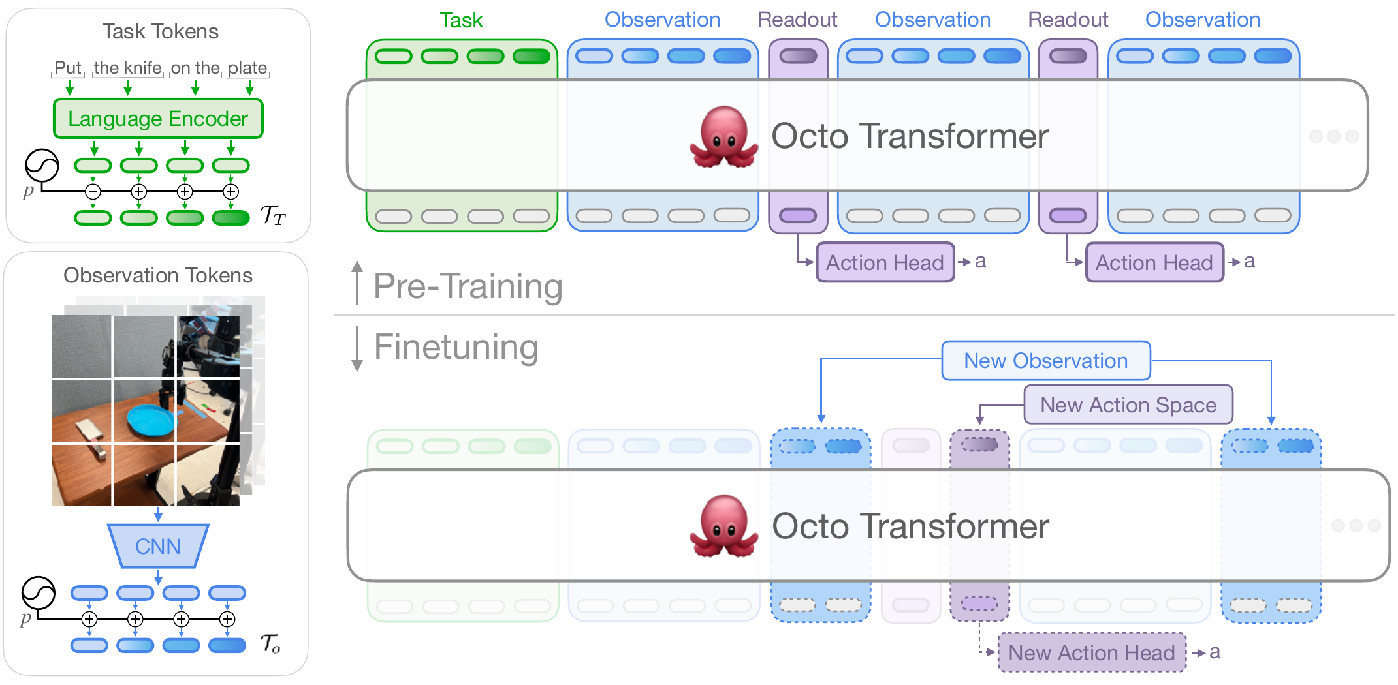
Architecture: tokens in, action chunks out
PART 1 · OCTO
Tokenizers
Language → frozen T5-base (111M). Images → shallow CNN patches.
Block-wise masked attention
Missing camera or no language label? Those tokens are simply masked out.
Readout tokens
Like BERT’s [CLS]: they summarise the observations for the head.
Diffusion action head
DDPM denoising predicts a chunk of future actions.
800k trajectories
25 Open X datasets
27M / 93M params
Figure: Octo paper, Fig. 2
05
Notes:
~3 min. Walk through the figure left to right. Task tokens: language through a frozen T5-base (111M); goal images and observations go through a lightweight CNN and are split into patches. Transformer backbone uses block-wise masking: observation tokens attend only to task tokens and earlier observations, so missing modalities are just masked. Readout tokens attend to observations but nothing attends to them (like a passive [CLS]). The diffusion head predicts a chunk of future actions; it can represent multi-modal action distributions (unlike MSE) while staying continuous and precise (unlike discrete bins). Bottom half of figure: fine-tuning adds new observation tokens or a new action head without changing pretrained weights' structure. Data: 800k trajectories, 25 datasets from Open X-Embodiment. Models: Octo-Small 27M, Octo-Base 93M.

Slide 6
Results: small model, big reach
PART 1 · OCTO
+29%
590×
+52%
< 5 h
success over RT-1-X (35M), zero-shot on 9 robot platforms
smaller than RT-2-X (55B), yet similar success on WidowX and RT-1 robot tasks
over the next-best baseline when fine-tuned, across 6 new setups
to fine-tune with ~100 demos on one A5000, incl. force-torque input or joint control
DESIGN LESSONS FROM THE ABLATIONS
Transformer-first beats big ResNet encoders on the full data mix
Diffusion head beats MSE and discretised action heads
Large shuffle buffer (up to 500k frames) keeps 25-dataset training stable
Octo Model Team et al., RSS 2024 · Fig. 4, Tables I–II, App. E
06
Notes:
~2 min. Zero-shot: on average 29% higher success than RT-1-X across 9 platforms; on WidowX and RT-1 robot it performed similarly to RT-2-X (55B), which is roughly 590x larger. With goal images instead of language, 25% higher success on WidowX. Fine-tuning: ~100 demos per domain, same hyperparameters everywhere, under 5 hours on one 24 GB A5000; outperforms next-best baseline by 52% on average, including new force-torque observations (Berkeley Insertion) and joint-position control (Berkeley Pick-Up). Ablations (Octo-Small): ViT-style transformer-first scales better than ResNet (ResNets only better on small data); diffusion head beats MSE and discretised heads; frame shuffle buffer up to 500k was crucial.

Slide 7
What problem does OpenVLA solve?
PART 2 · OPENVLA
The problem
OpenVLA’s answer
RT-2 showed that internet-scale VLMs make robots generalise far better.
A 7B open-source VLA built on Llama 2.
Trained on 970k robot trajectories from Open X-Embodiment.
But those VLA models were closed.
Nobody had shown how to fine-tune or run them cheaply.
Adapted with LoRA, served with 4-bit quantization.
GOAL
Bring VLM-level generalisation to everyone, on a single GPU.
Kim et al., CoRL 2024 · arXiv:2406.09246
07
Notes:
~2 min. A VLA is a vision-language model fine-tuned to output robot actions. RT-2 / RT-2-X proved the idea but are closed, and prior work did not study efficient fine-tuning. OpenVLA: 7B parameters, open weights and code, trained on 970k episodes from Open X-Embodiment. Pretraining is expensive (64 A100s for 14 days), but adaptation is cheap: LoRA fine-tuning on one GPU and 4-bit quantized inference.

Slide 8
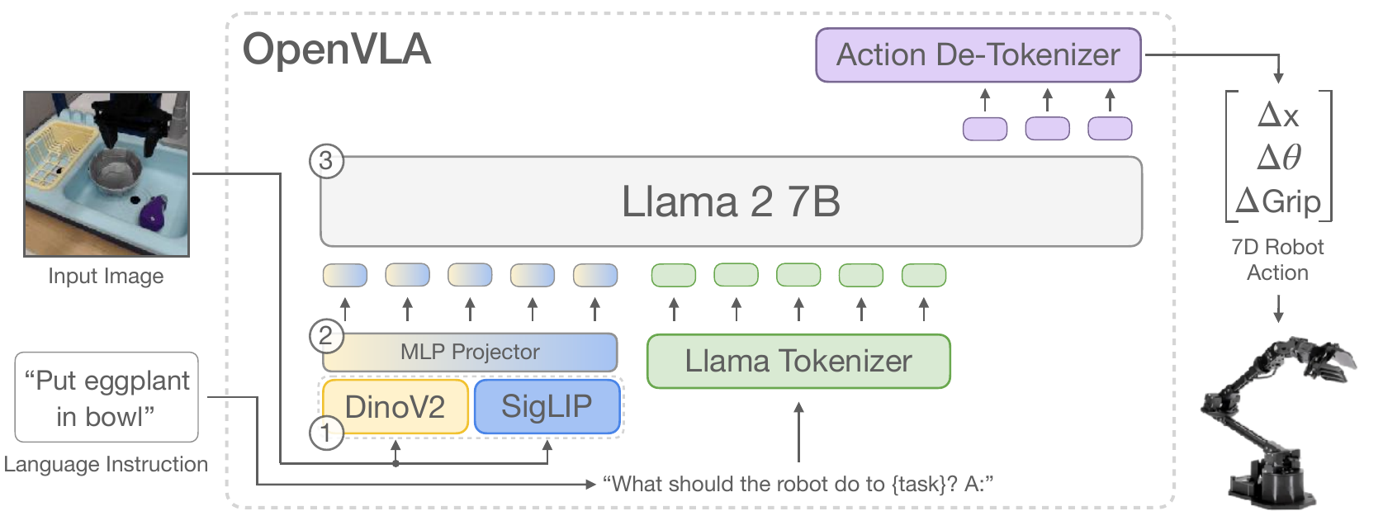
Architecture: a VLM that speaks in actions
PART 2 · OPENVLA
① Fused vision encoder
② MLP projector
③ Llama 2 7B
DINOv2 (spatial detail) + SigLIP (semantics), ~600M
maps image patches into the LLM’s token space
from Prismatic-7B VLM; outputs action tokens
Figure: OpenVLA paper, Fig. 2
08
Notes:
~1.5 min. OpenVLA starts from the Prismatic-7B VLM. (1) Vision encoder: image patches pass through both SigLIP and DINOv2 and the features are concatenated. SigLIP gives high-level semantics; DINOv2 gives low-level spatial detail, which helps precise manipulation. (2) A 2-layer MLP projector maps visual features into the language embedding space. (3) Llama 2 7B reads the image tokens plus the prompt "What should the robot do to {task}?" and generates action tokens, which are de-tokenized into a 7D action. Prismatic was chosen after the authors also tried IDEFICS-1 and LLaVA; it did best on their language-grounding tests.

Slide 9

The LLM trick: actions become tokens
PART 2 · OPENVLA
1
2
3
4
7-D action
256 bins
Bin → token
Next-token loss
Δposition, Δrotation and gripper: continuous values
uniform bins per dimension, between the 1st and 99th percentile
each bin overwrites one of the 256 least-used Llama tokens
cross-entropy, computed on the action tokens only
Why percentiles? Outlier actions would stretch the bins and waste resolution.
Result: no new output head. Robot control is just language modelling.
Kim et al., CoRL 2024 · Section 3.2
09
Notes:
~1.5 min. The key trick that lets an unchanged LLM control a robot. Each of the 7 action dimensions is discretised separately into 256 uniform bins; bin edges span the 1st to 99th percentile of the training actions (RT-2 used min-max, which outliers can stretch). Llama's tokenizer only reserves 100 special tokens, too few for 256 bins, so the 256 least-used tokens in the vocabulary are overwritten with action bins. Training is plain next-token prediction with cross-entropy, evaluated only on action tokens. Contrast with Octo: Octo keeps actions continuous with a diffusion head. Other training details: 27 epochs (far more than typical VLM training), fixed learning rate 2e-5.

Slide 10
Results: stronger, and cheap to adapt
PART 2 · OPENVLA
+16.5%
+20.4%
1.4%
7 GB
absolute success over RT-2-X (55B) on 29 tasks, with 7× fewer parameters
over Diffusion Policy from scratch on multi-task, language-grounded fine-tuning
of weights trained with LoRA (r = 32): 68.2% vs 69.7% for full fine-tuning
VRAM at 4-bit, down from 16.8 GB, with the same success (71.9% vs 71.3%)
THE COMPUTE PICTURE
Pretraining: 64 A100 GPUs for 14 days
LoRA fine-tune: 10–15 h on one A100, 8× less compute
Inference: about 6 Hz on one RTX 4090
Kim et al., CoRL 2024 · Sections 3.5, 5.1–5.4, Tables 1–2
10
Notes:
~2 min. Zero-shot on WidowX (BridgeData V2) and Google robot: OpenVLA beats RT-2-X by 16.5% absolute across 29 tasks with 7x fewer parameters; RT-1-X and Octo struggled more on these tests. Fine-tuning to new Franka setups: beats Diffusion Policy trained from scratch by 20.4% on diverse multi-instruction tasks (Diffusion Policy is still better on narrow single-instruction dexterous tasks). LoRA rank 32 on all linear layers trains 97.6M params (1.4%) and matches full fine-tuning (68.2% vs 69.7%); rank had little effect. Quantization: int4 uses 7.0 GB vs 16.8 GB in bf16 with equal success; int8 was actually worse (58.1%) because it is slower on GPU and changes system dynamics. Note: the LoRA and quantization experiments used a slightly smaller SigLIP-only OpenVLA variant.

Slide 11
Side by side
PART 3 · COMPARISON
Feature | Octo | OpenVLA
Size | 27M (Small) / 93M (Base) | 7B
Backbone | Custom transformer, trained from scratch | Llama 2 7B + DINOv2 + SigLIP (pretrained VLM)
Actions | Continuous action chunks, diffusion head | Discrete tokens, 256 bins per dimension
Inputs | Language or goal image; several cameras, proprio | One image + language instruction
Data | 800k trajectories, 25 Open X datasets | 970k trajectories, Open X (same mix weights)
Fine-tuning | Full, < 5 h on one A5000 | LoRA, 10–15 h on one A100
Footprint | Light: under 100M params | 15 GB in bf16, 7 GB at 4-bit
Sources: Octo (RSS 2024), OpenVLA (CoRL 2024)
11
Notes:
~2 min. Read across rows; the key contrast is design philosophy. Octo: small, built from scratch for flexibility (any inputs, new heads), continuous diffusion actions. OpenVLA: reuse a big internet-pretrained VLM and treat actions as text. Data: OpenVLA reused Octo's mixture weights; it tried adding DROID at 10% weight but removed it for the final third of training because the model could not fit it. Footprint: OpenVLA needs about 15 GB in bf16 or 7 GB at 4-bit; Octo is under 100M parameters.

Slide 12
Limitations the authors point out
PART 3 · COMPARISON
Octo
OpenVLA
Weak with wrist cameras: only 27% of the data has them
Language conditioning lags goal images (+25% with goal images)
No web-scale pretraining, so weaker on unseen objects and concepts
One image only: no wrist camera, proprioception or history
About 6 Hz: too slow for 50 Hz dexterous control
Still under 90% success on the tested tasks
On narrow, single-instruction tasks, a from-scratch Diffusion Policy is still smoother and more precise than both.
Octo §V & §VI · OpenVLA §5.2 & §6
12
Notes:
~1 min. Being fair to both. Octo: struggles with wrist-camera inputs (only 27% of pretraining data has wrist cameras); language-conditioned performance is lower than goal-image-conditioned (goal images gave 25% higher success on WidowX), since only 56% of data has language labels. In OpenVLA's experiments, Octo and RT-1-X often manipulated the wrong object, which the OpenVLA authors attribute to lacking internet-scale pretraining. OpenVLA: single image observation only; ~6 Hz on a 4090 makes high-frequency setups like ALOHA (50 Hz) out of reach; typically below 90% success. Both generalists lose to Diffusion Policy on narrow, dexterous single-instruction tasks, where action chunking and temporal smoothing help.

Slide 13
Which one should you choose?
CONCLUSION
Choose Octo when you…
Choose OpenVLA when you…
have limited compute or need a light model
use custom sensors or action spaces (force-torque, joints)
want to specify tasks with goal images
need strong language grounding in cluttered, multi-object scenes
want the best out-of-the-box generalisation
can use LLM tooling: LoRA, 4-bit quantization
Octo shows how flexible a small policy can be;
OpenVLA shows how much internet knowledge carries over to robots.
Octo vs. OpenVLA · Machine Learning & Deep Learning
13
Notes:
~1 min. Octo: lightweight, flexible inputs/outputs, fast full fine-tuning on one 24 GB GPU, goal-image conditioning. OpenVLA: better semantic generalisation and language grounding thanks to internet-scale VLM pretraining, and it plugs into LLM tooling (LoRA, quantization, inference servers), at the cost of size and speed. Both are fully open, which is the real contribution for the research community. A natural next step combines them: VLM knowledge with flexible inputs and continuous, chunked action heads.

Slide 14
Thank you
Questions?
REFERENCES
Octo Model Team et al. “Octo: An Open-Source Generalist Robot Policy.” RSS 2024. arXiv:2405.12213
Kim et al. “OpenVLA: An Open-Source Vision-Language-Action Model.” CoRL 2024. arXiv:2406.09246
M. Haroon Khan · Mayet Bekele Sharew · Ahmad Rammal · Maksym Necheporenko
Notes:
Thank the professor and open for questions. Likely questions: why diffusion vs discrete tokens (multi-modality vs reuse of LLM machinery); why 27 epochs for OpenVLA; what Open X-Embodiment is (~1.5M episodes pooled from many labs); could you run either on a real lab robot (Octo on one consumer GPU; OpenVLA at 4-bit on a 4090-class GPU).

